Slide 1
Image Enhancement
Pixel/Intensity Transformation
Histogram Processing
Spatial Filtering

Slide 2
Image Enhancement
Image enhancement is a process to make the result more suitable than the original image for a specific application
Image enhancement is a subjective (problem/application oriented) image enhancement approch.
Spatial domain: Direct manipulation of pixel in an image (on the image plane)
Frequency domain: Processing the image based on modifying the Fourier transform of an image
Many techniques are based on various combinations of methods from these two categories

Slide 3
Image Enhancement
Goals:
To improve the subjective quality of an image for human viewing; (an image needs improvement)
To modify the image in such a way as to make it more suitable for further analysis and automatic extraction of its contents. (low-level features extraction)

Slide 4
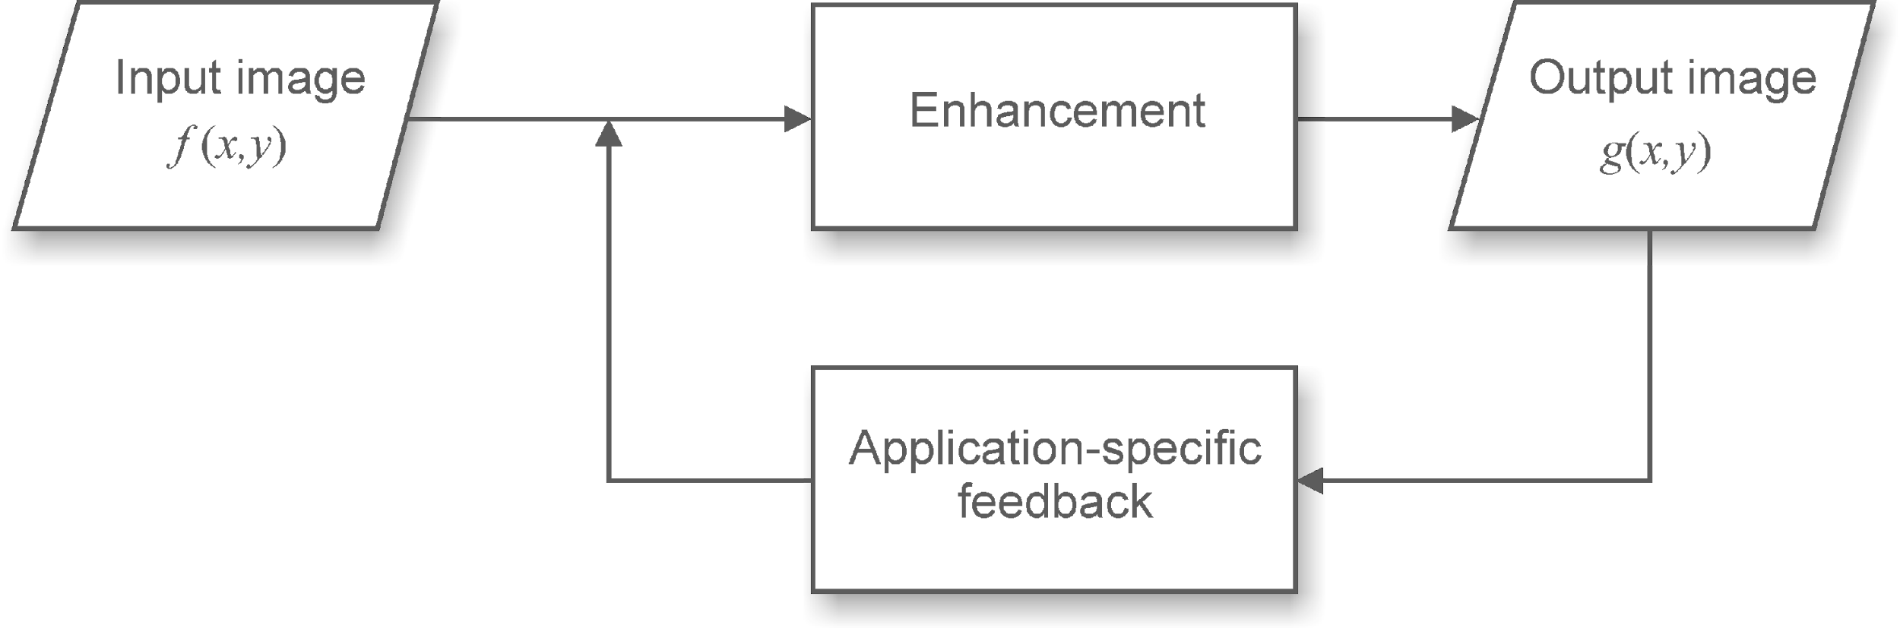
Image Enhancement Process

Slide 5
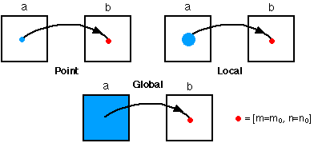
Image Enhancement
Types of image enhancement operations
Point/pixel operations: Output value at specific coordinates (x,y) is dependent only on the input value at (x,y)
Local operations: The output value at (x,y) is dependent on the input values in the neighborhood of (x,y)
Global operations: The output value at (x,y) is dependent on all the values in the input image

Slide 6
Basic concepts
Spatial domain enhancement methods can be generalized as
g(x,y)=T[f(x,y)]
f(x,y) : input image
g(x,y): processed (output) image
T[*] : an operator on f (or a set of input images), defined over intensity (x,y) or neighborhood of (x,y)
Neighborhood about (x,y): a square or rectangular sub-image area centered at (x,y)

Slide 7
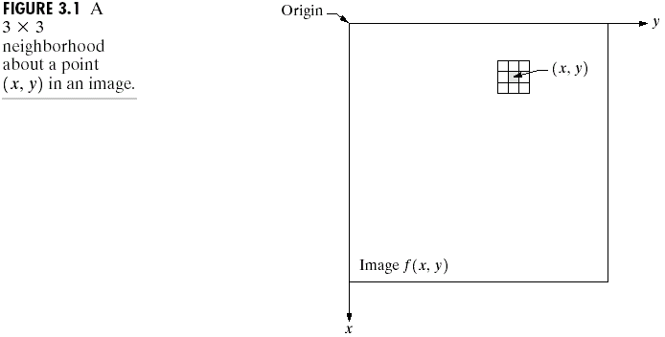
Basic Concepts
3x3 neighborhood about (x,y)

Slide 8
Basic concepts
Pixel/Point operation:
Neighborhood of size 1x1: g depends only on f at (x,y)
T: a gray-level/intensity transformation/mapping function
Let r = f(x,y) s = g(x,y)
r and s represent gray levels of f and g at (x,y)
Then s = T(r)
Local operations: g depends on the predefined number of neighbors of f at (x,y) implemented by using mask processing or filtering
Masks (filters, windows, kernels, templates) : a small (e.g. 3×3) 2-D array, in which the values of the coefficients determine the nature of the process

Slide 9
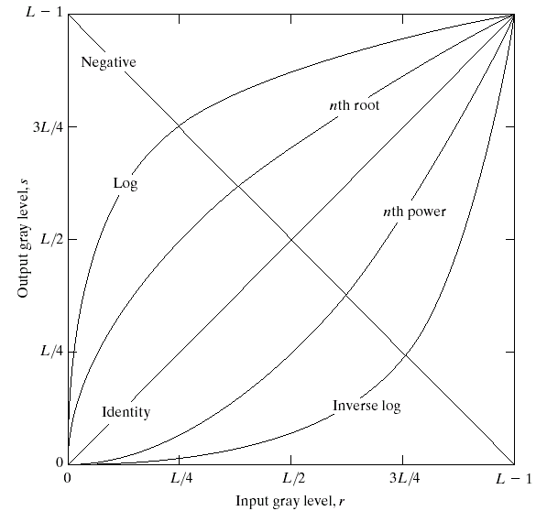
Common pixel operations
Image negatives
Log transformations
Power-law transformations
Contrast stretching

Slide 10
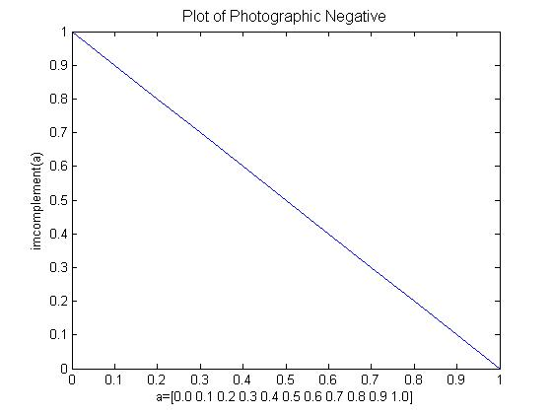
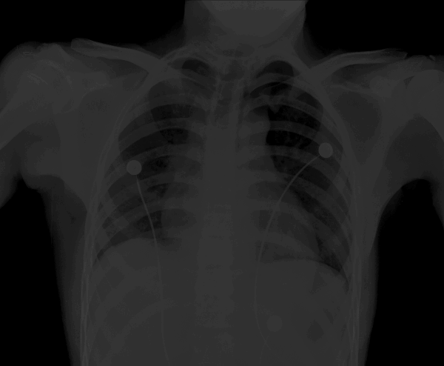
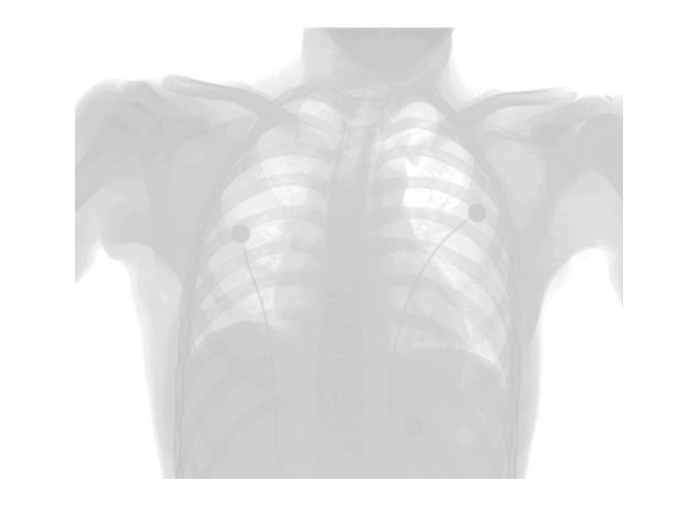
Image Negative
Reverses the gray level order
For L gray levels the transformation function is:
Here L = 2.
s = (L – 1) – r, where r ∈ [0, L-1].
>> f = imread('xray.tif');
>> g = imcomplement(f);
>> imshow(f), figure, imshow(g)

Slide 11
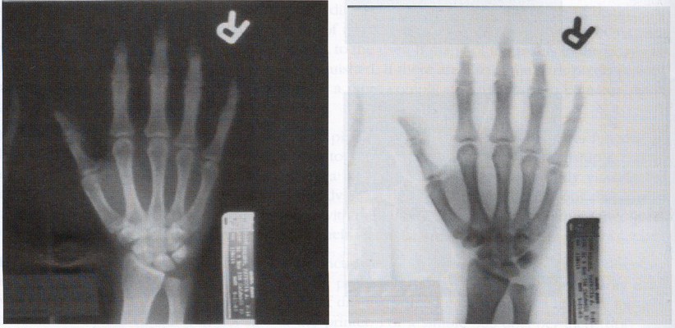
Image negatives
s =T(r) = (L-1)-r
Input image (X-ray image) Output image (negative)

Slide 12
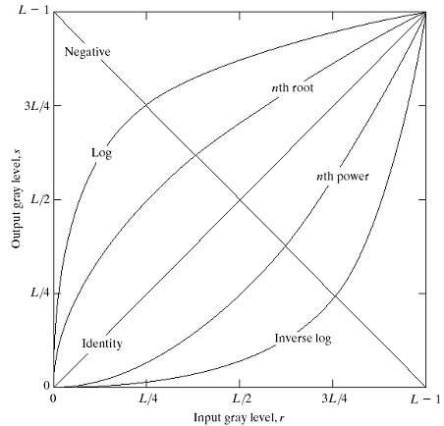
Log transformations
Function of s = c Log(1+r)

Slide 13
Log transformations
Properties of log transformations
For lower amplitudes of input image the range of gray levels is expanded
For higher amplitudes of input image the range of gray levels is compressed
Application:
Dynamic range of a processed image far exceeds the capability of the display device
(e.g. display of the Fourier spectrum of an image)
Also called “dynamic-range compression / expansion”

Slide 14
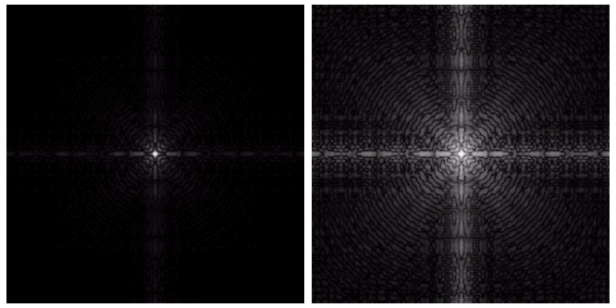
Log transformations
Fourier spectrum with values of range 0 to 1.5 x 10⁶ scaled linearly
The result applying log transformation, c = 1

Slide 15
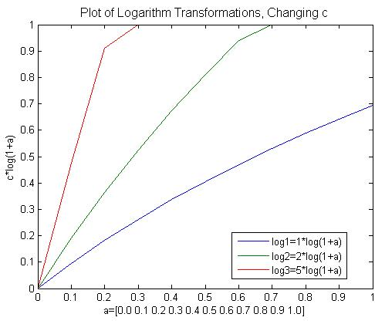
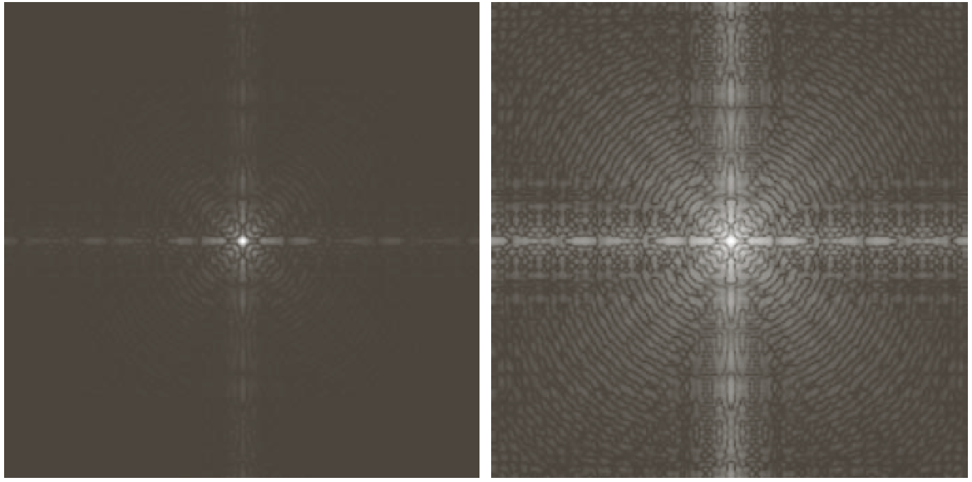
Log transformation
Used to compress the dynamic range of values within an image.
s = c log(1 + double(r)), where c is constant
>> f = imread('spectrum.tif');
% here c = 1
>> g = im2uint8(mat2gray(log(1+double(f))));
>> imshow(f), figure, imshow(g)

Slide 16
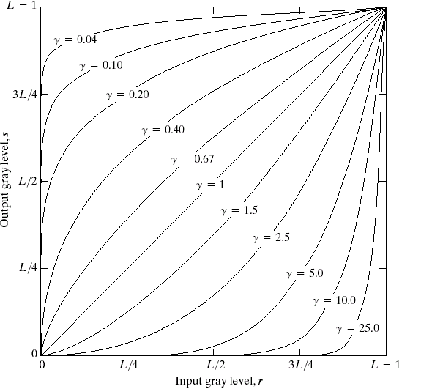
Power-law Transformation
Basic form:
s = cr^{γ} ,
where c & γ
are positive
Plots of equation s = cr^{γ}, For various values of γ (c = 1)

Slide 17
Power-law Transformation
For γ < 1: Expands values of dark pixels, compress values of brighter pixels
For γ > 1: Compresses values of dark pixels, expand values of brighter pixels
If γ=1 & c=1: Identity transformation (s = r)
A variety of devices (image capture, printing, display) respond according to a power law and need to be corrected;
Gamma (γ) correction
The process used to correct the power-law response phenomena

Slide 18
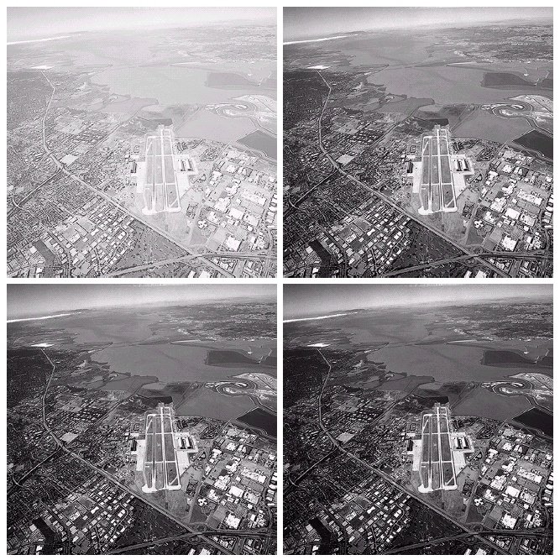
Power-law Transformation: Example
Original satellite image
Result of applying power-law transformation
c = 1, γ = 3.0
Result of applying power-law transformation
c = 1, γ = 4.0
Result of applying power-law transformation
c = 1, γ = 5.0

Slide 19
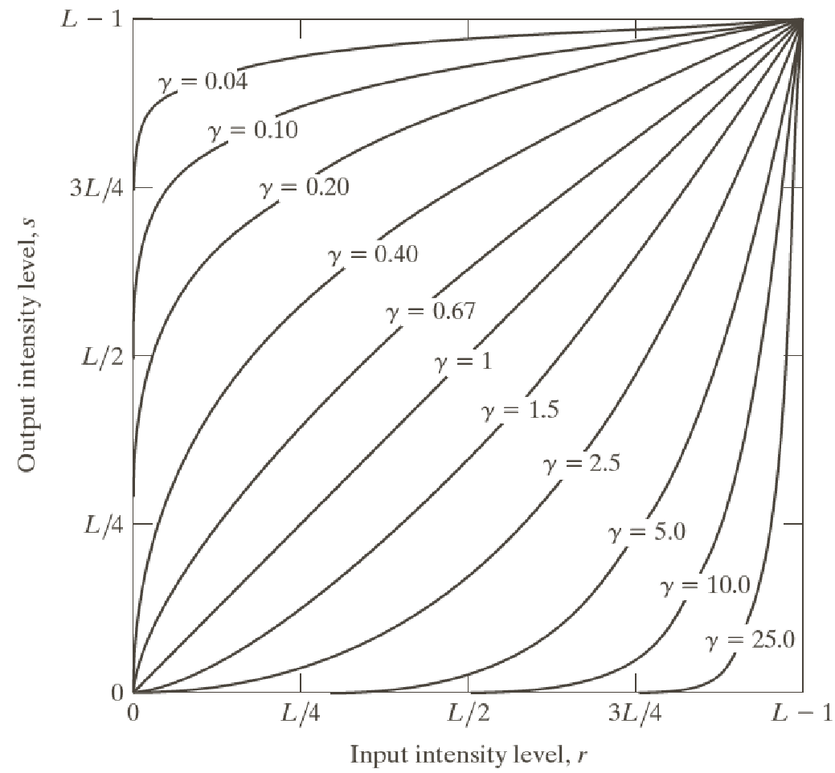
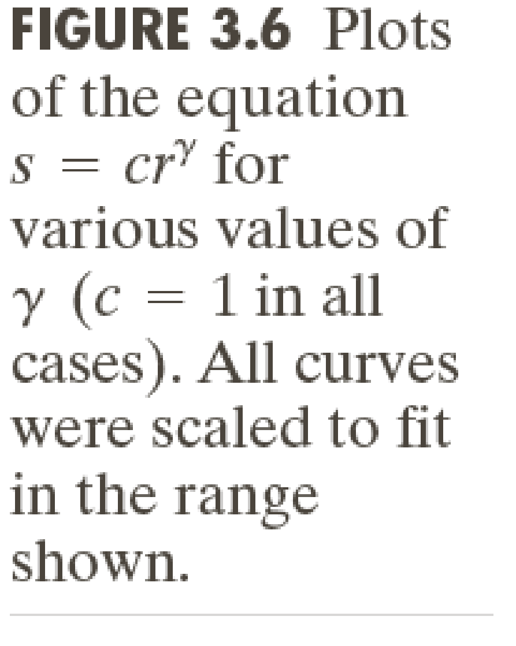
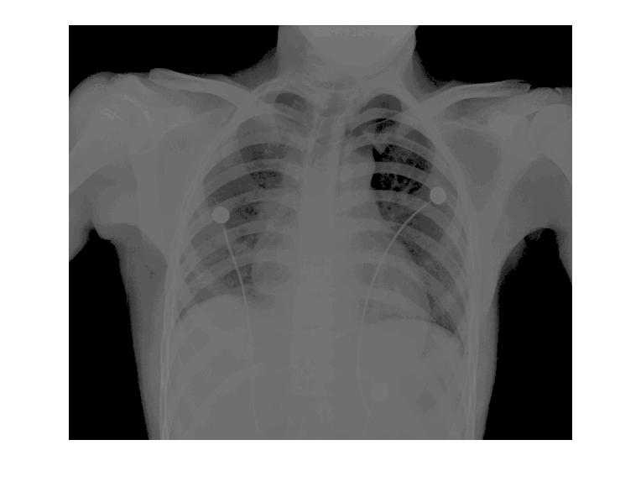
Power-Law Transformation Example
Useful for brightening the darkest regions (0 < γ < 1) or darkening the brightest regions in an image (γ > 1).
s = r^{γ}
Syntax:
g = imadjust(f, [low_in high_in], [low_out high_out], gamma);
>> f = imread('xray.tif');
>> g = imadjust(f, [ ], [ ], 0.5);
>> imshow(f), figure, imshow(g)

Slide 20
Contrast stretching
Goal:
Increase the dynamic range of the gray levels for low contrast images
Low-contrast images can result from
poor illumination
lack of dynamic range in the imaging sensor
wrong setting of a lens aperture during image acquisition

Slide 21
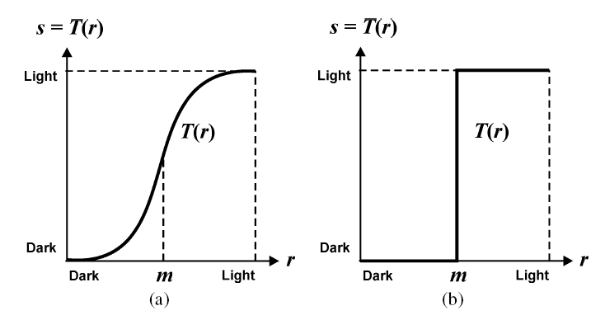
Contrast-Stretching

Slide 22
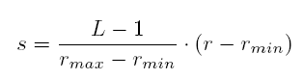
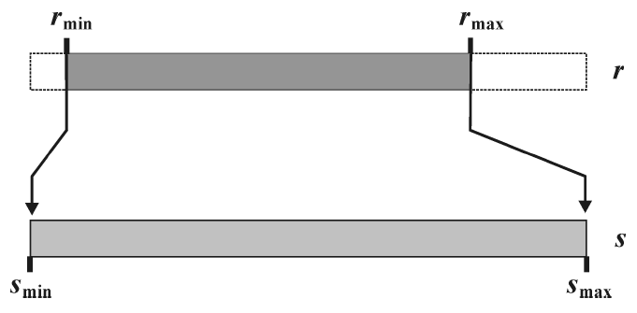
Contrast-Stretching
Auto Contrast

Slide 23
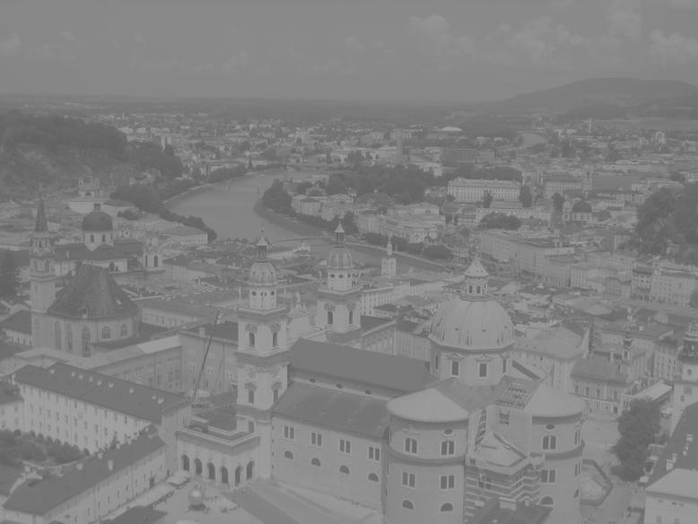

Contrast-Stretching
Auto Contrast Example
I = imread('salzburg_before.png');
f = double(I);
fmin = min(min(f))
fmax = max(max(f))
g = uint8(255*(f-fmin)/(fmax-fmin));
imshow(g)

Slide 24
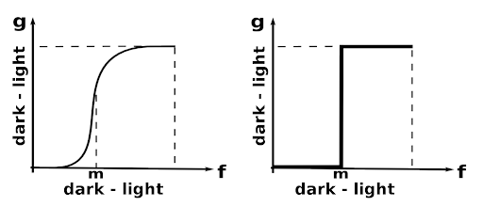
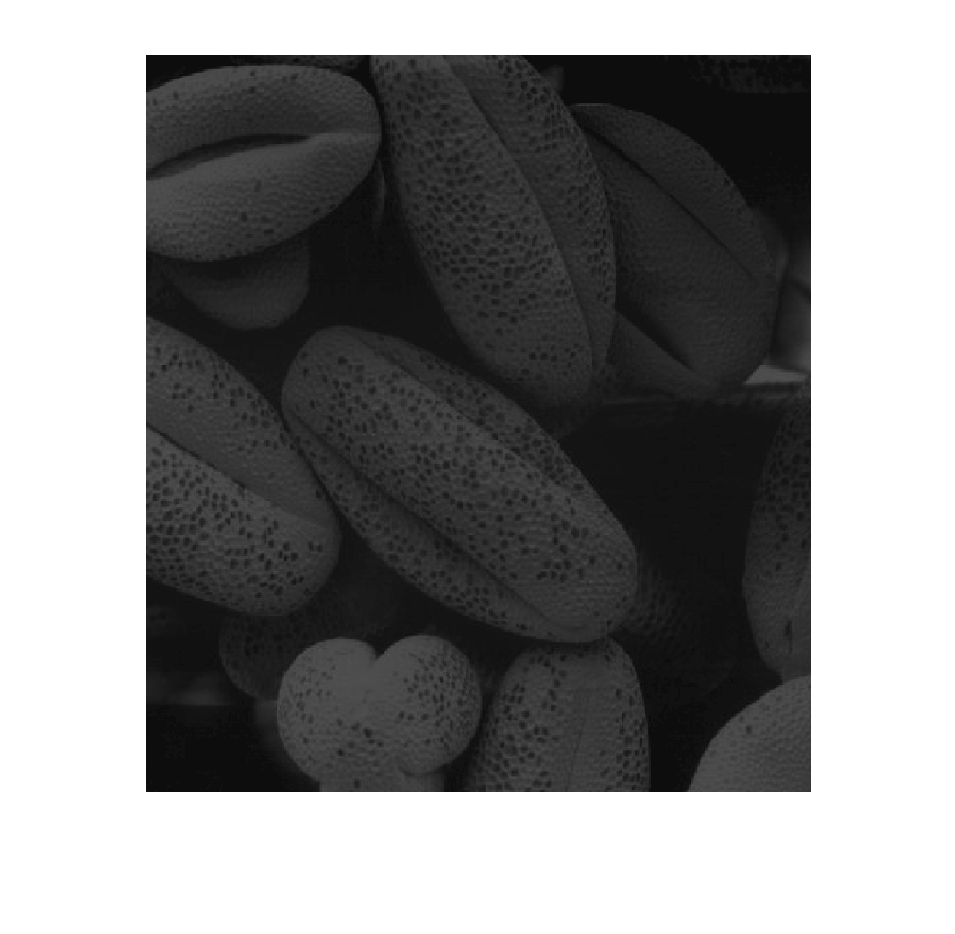
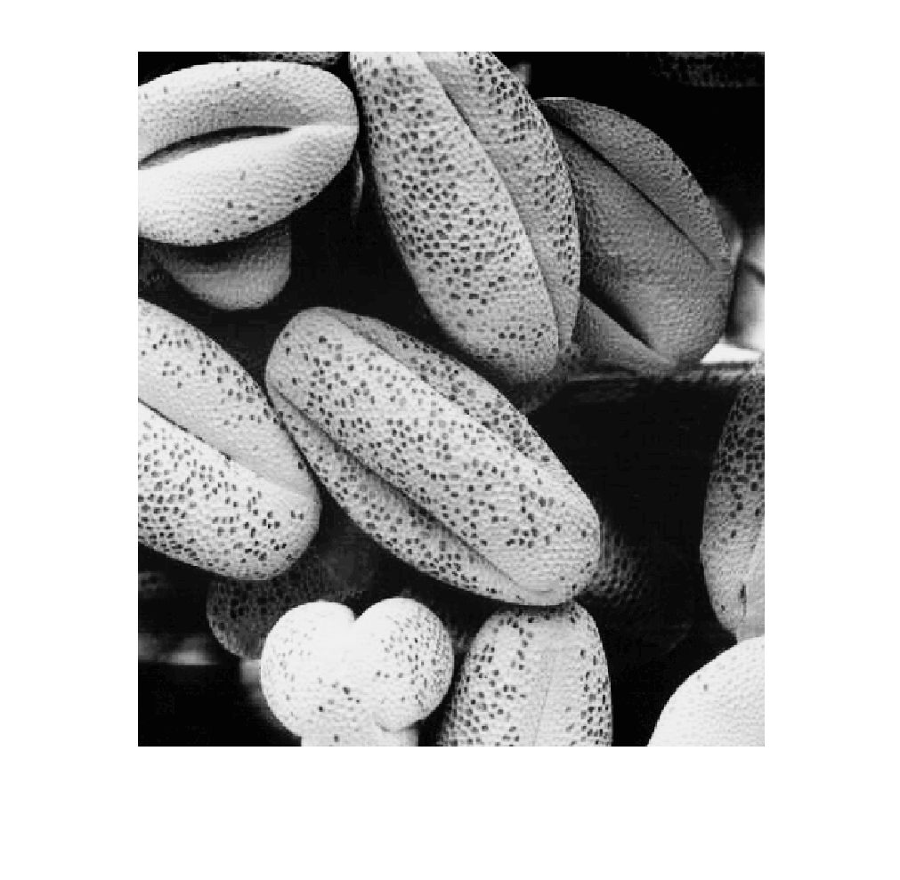
Contrast-Stretching
s = T(r) = 1 / (1 + (m/r)^{E}), where 0 < m < r
Output values are scaled to the range [0, 1]
g = 1./(1 + (m./(double(f) + eps)).^E)
>> f = imread('pollen.tif');
>> fd = im2double(f);
>> m = mean2(fd)
>> g = 1./(1+(m./(fd+eps)).^4);
>> imshow(f), figure, imshow(g)

Slide 25
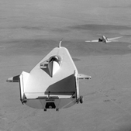
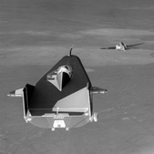
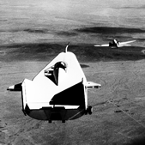
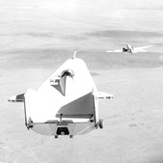
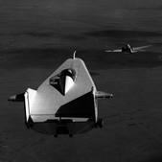
Exercise
Identify which intensity transformation was used on liftingbody.png to create each of the four results below. Write a script to reproduce the results using the intensity transformation functions.
Original
Result 1 Result 2 Result 3 Result 4

Slide 26
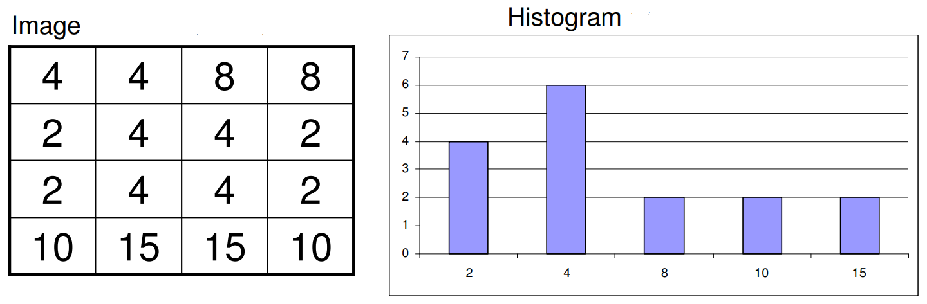
What is a Histogram?
An image histogram is a gray-scale value distribution showing the frequency of occurrence of each gray-level value.

Slide 27
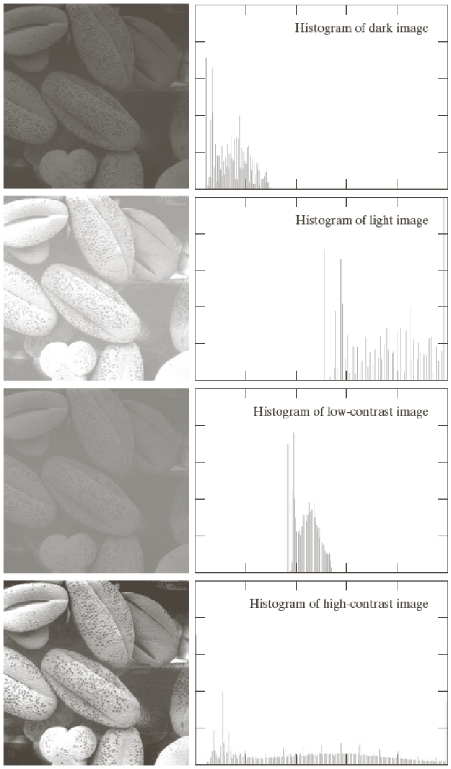
Histogram Processing
Generating & Plotting Image Histograms:
h(r_{k}) = n_{k}
where r_{k} is the k^{th} intensity value,
n_{k} is the number of pixels in the image with
intensity r_{k}.
Normalized Histogram:
p(r_{k}) = h(r_{k})/n
= n_{k}/n, (Relative frequency)
where n = MxN, the size of image
>> imhist(f);

Slide 28
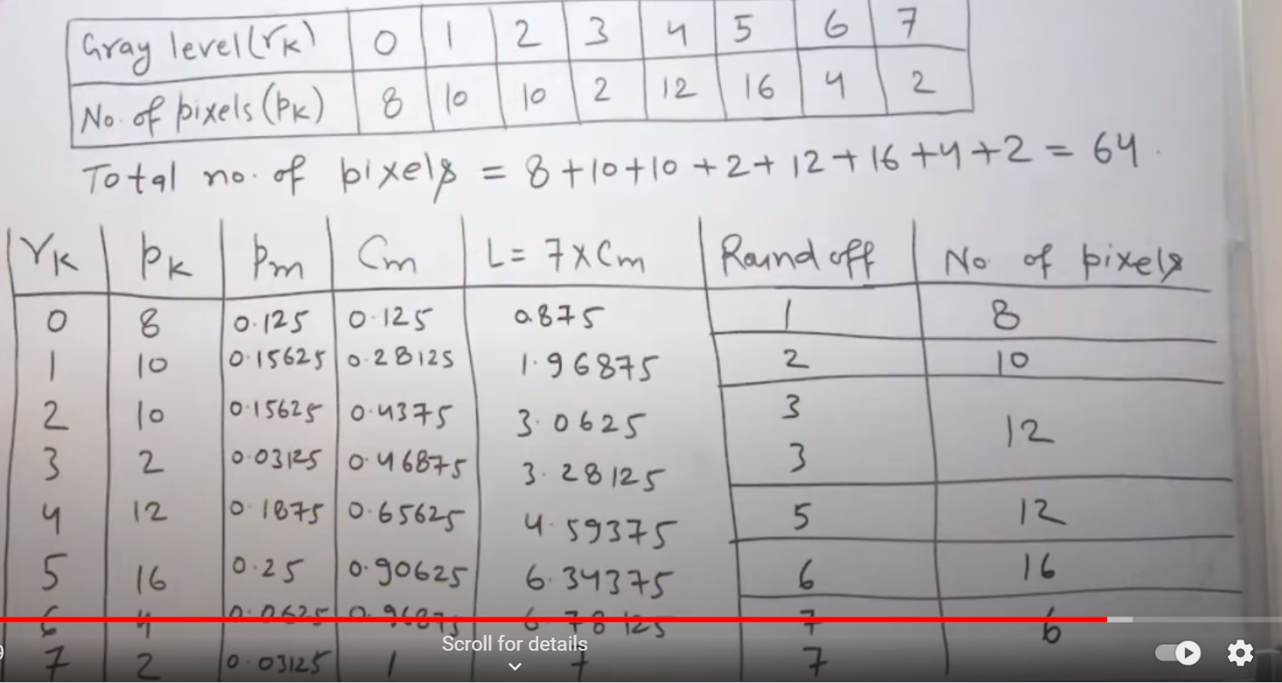

Slide 29
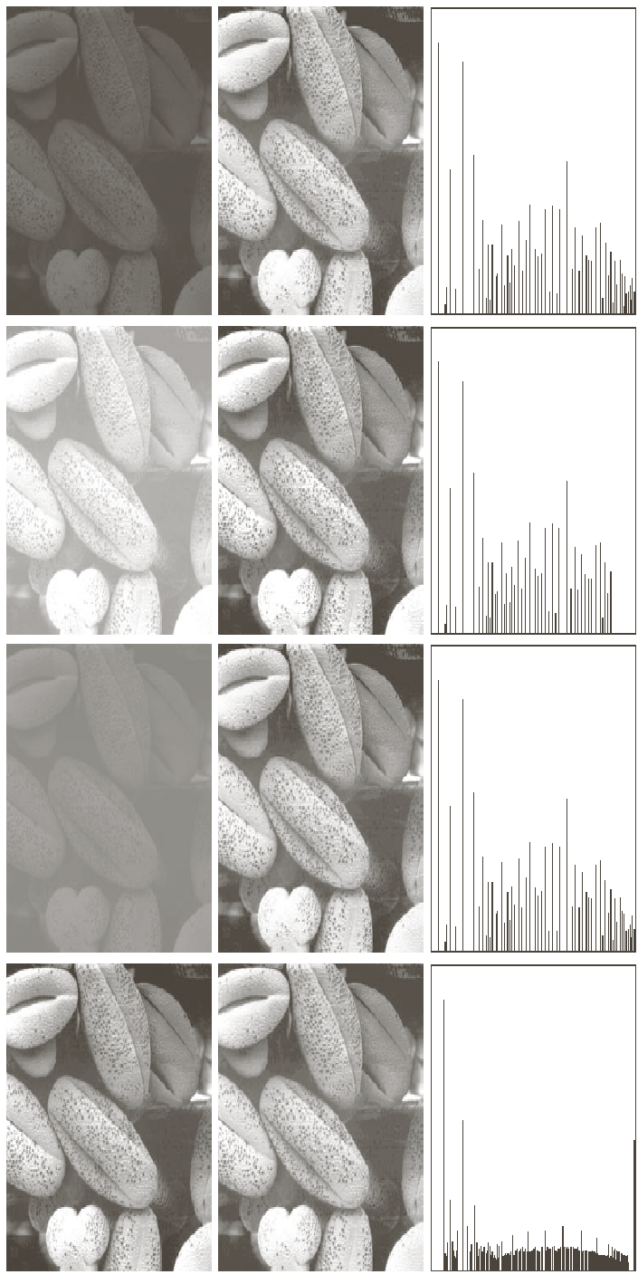
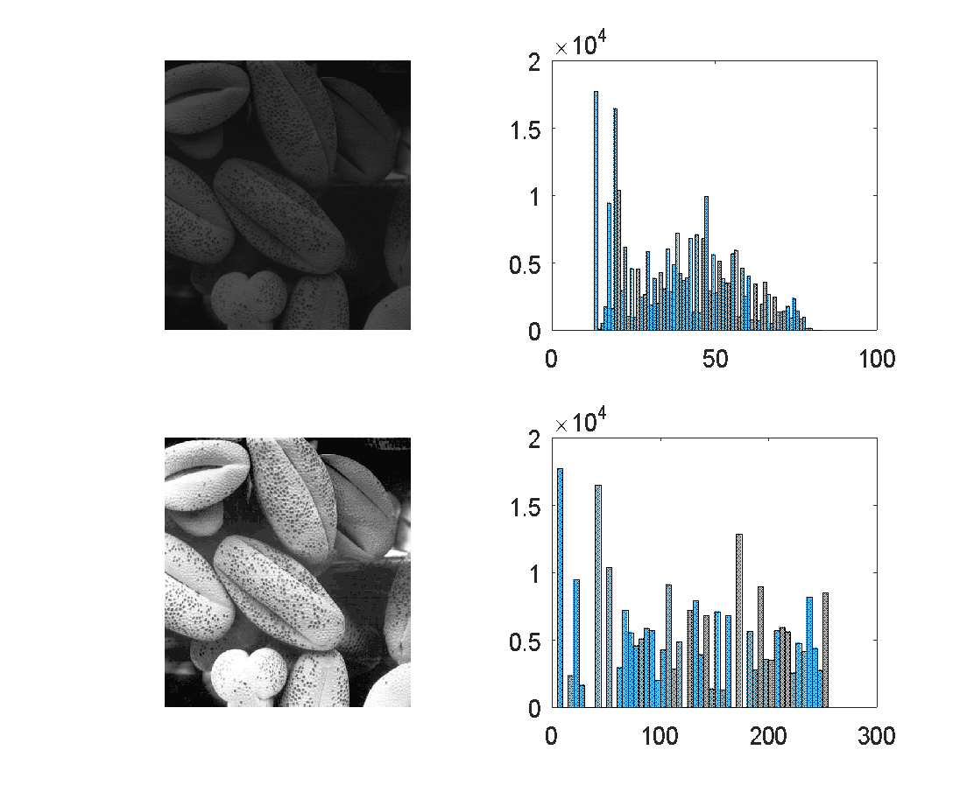
Histogram Equalization
>> f = imread('pollen.tif');
>> h = histeq(f);
>> subplot(2,2,1), imshow(f), subplot(2,2,2), histogram(f), subplot(2,2,3), imshow(h), subplot(2,2,4), histogram(h)

Slide 30

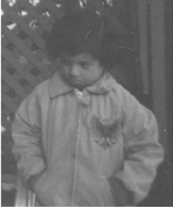


Exercise
Write a program which can read an image as an input and do the following automatically. Show the results of all steps.
Find the type of image: binary, gray or RGB.
Find the issue in image, over dark, over bright, low contrast, or normal. (Hint: can use histogram).
Resolve the issue if any and show the final image after enhancement.
Test your program on following images:

Slide 31
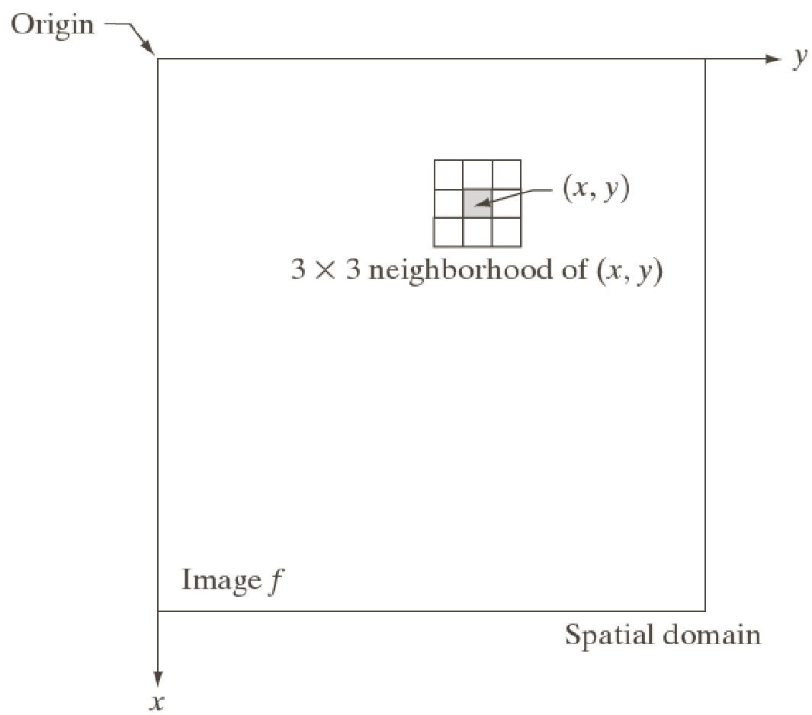
Neighborhood Processing

Slide 32
Spatial Filtering
w₁ w₂ w₃
w₄ w₅ w₆
w₇ w₈ w₉
f₁ f₂ f₃
f₄ f₅ f₆
f₇ f₈ f₉
g₁ g₂ g₃
g₄ g₅ g₆
g₇ g₈ g₉
g₅ = f₁*w₁+ f₂*w₂+ f₃*w₃+ f₄*w₄+ f₅*w₅+ f₆*w₆+ f₇*w₇+ f₈*w₈+ f₉*w₉

Slide 33
Spatial Filtering - Without Padding
Mask (Filter) Given Image Filtered Image
0 -1 0
-1 4 -1
0 -1 0
2 3 5 7 2
3 4 7 5 2
5 6 5 3 1
2 6 2 2 1
7 3 3 2 0
-3 ? ?
? ? ?
? ? ?
2*0 + 3*(-1) + 5*0 + 3*(-1) + 4*4 + 7*(-1) + 5*0 + 6*(-1) + 5*0 = -3

Slide 34
Spatial Filtering - With Zero Padding
0 -1 0
-1 4 -1
0 -1 0
2 3 5 7 2
3 4 7 5 2
5 6 5 3 1
2 6 2 2 1
7 3 3 2 0
2

Slide 35
Spatial Filtering - With Zero Padding
0 -1 0
-1 4 -1
0 -1 0
2 3 5 7 2
3 4 7 5 2
5 6 5 3 1
2 6 2 2 1
7 3 3 2 0
2
1

Slide 36
Spatial Filtering - With Zero Padding
0 -1 0
-1 4 -1
0 -1 0
2 3 5 7 2
3 4 7 5 2
5 6 5 3 1
2 6 2 2 1
7 3 3 2 0
2 1
3

Slide 37
Spatial Filtering - With Zero Padding
0 -1 0
-1 4 -1
0 -1 0
2 3 5 7 2
3 4 7 5 2
5 6 5 3 1
2 6 2 2 1
7 3 3 2 0
2 1 3
16

Slide 38
Spatial Filtering - With Zero Padding
0 -1 0
-1 4 -1
0 -1 0
2 3 5 7 2
3 4 7 5 2
5 6 5 3 1
2 6 2 2 1
7 3 3 2 0
2 1 3 16
-1

Slide 39
Spatial Filtering - With Zero Padding
0 -1 0
-1 4 -1
0 -1 0
2 3 5 7 2
3 4 7 5 2
5 6 5 3 1
2 6 2 2 1
7 3 3 2 0
2 1 3 16 -1
1

Slide 40
Spatial Filtering - With Zero Padding
0 -1 0
-1 4 -1
0 -1 0
2 3 5 7 2
3 4 7 5 2
5 6 5 3 1
2 6 2 2 1
7 3 3 2 0
2 1 3 16 -1
1
-3

Slide 41
Spatial Filtering - Padding Options
>> f=[1 2; 3 4]
f =
1 2
3 4
>> fp=padarray(f, [2 2], 0)
fp =
0 0 0 0 0 0
0 0 0 0 0 0
0 0 1 2 0 0
0 0 3 4 0 0
0 0 0 0 0 0
0 0 0 0 0 0
>> fp=padarray(f, [2 2], 'symmetric')
fp =
4 3 3 4 4 3
2 1 1 2 2 1
2 1 1 2 2 1
4 3 3 4 4 3
4 3 3 4 4 3
2 1 1 2 2 1
>> fp=padarray(f, [2 2], 'replicate')
fp =
1 1 1 2 2 2
1 1 1 2 2 2
1 1 1 2 2 2
3 3 3 4 4 4
3 3 3 4 4 4
3 3 3 4 4 4
>> fp=padarray(f, [2 2], 'circular')
fp =
1 2 1 2 1 2
3 4 3 4 3 4
1 2 1 2 1 2
3 4 3 4 3 4
1 2 1 2 1 2
3 4 3 4 3 4

Slide 42
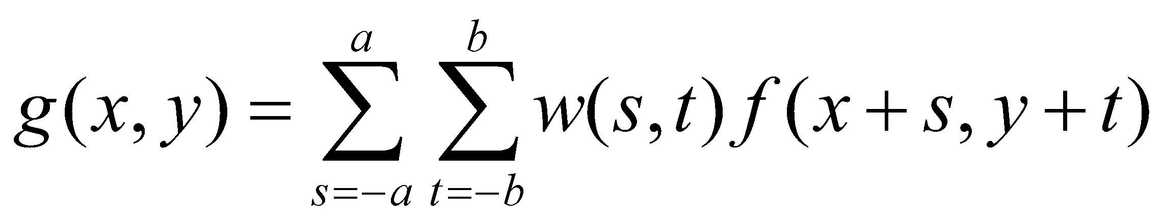
Basic Types of Spatial Filtering
In spatial filtering (vs. frequency domain filtering), the output image is computed directly by simple calculations on the pixels of the input image.
Spatial filtering can be either linear or non-linear.
For each output pixel, some neighborhood of input pixels is used in the computation.
In general, linear filtering of an image f of size MxN with a filter mask of size mxn is given by
where a = (m-1)/2 and b = (n-1)/2
This concept is called convolution. Filter masks are sometimes called convolution masks or convolution kernels.

Slide 43
Basic Types of Spatial Filtering
Nonlinear spatial filtering usually uses a neighborhood too, but some other mathematical operations are used. These can include conditional operations (if …, then …), statistical (sorting pixel values in the neighborhood, mean, median), etc.

Slide 44
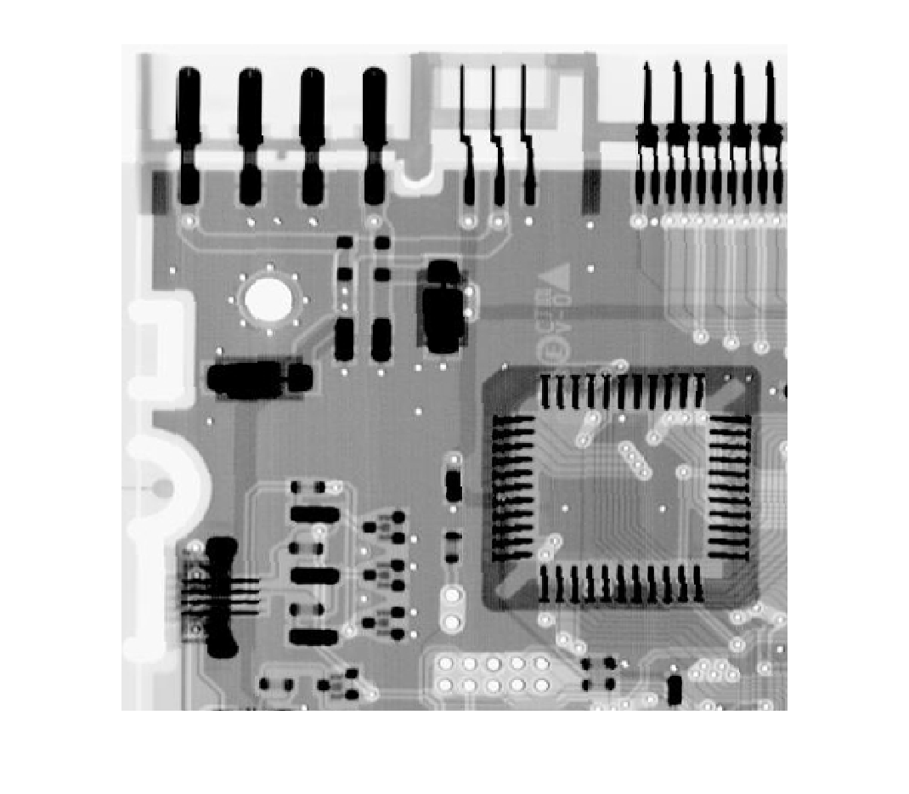
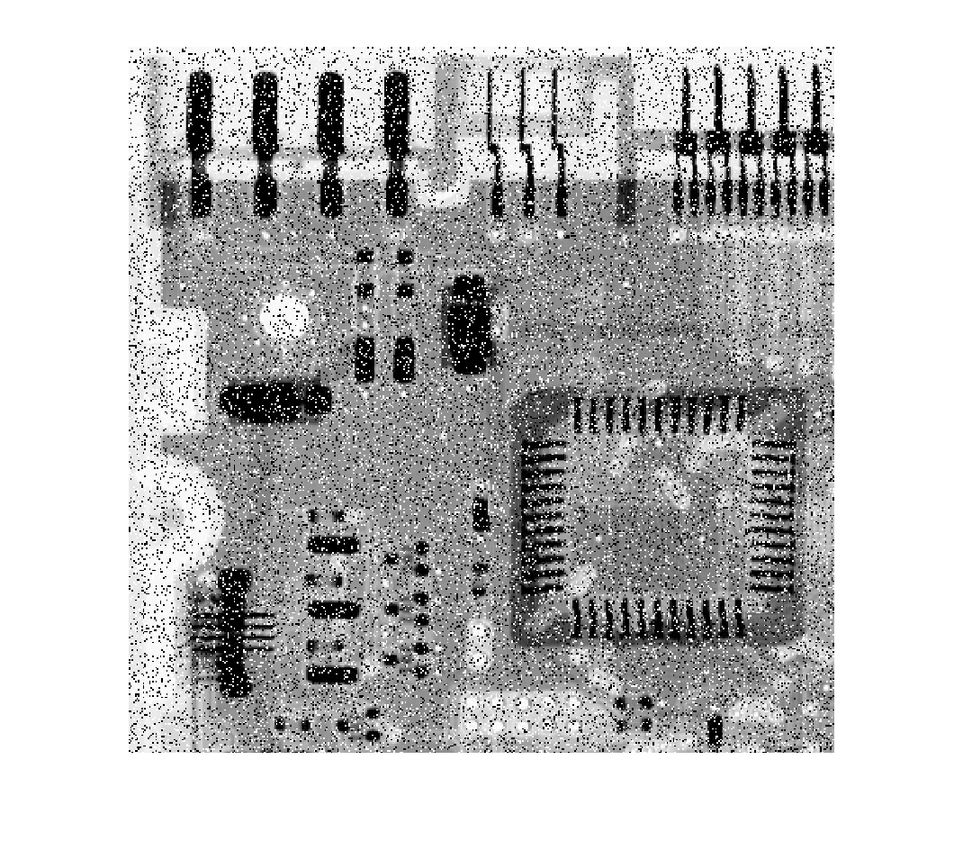


Nonlinear Spatial Filtering - Example
>> f = imread('cktboard.tif');
>> fn = imnoise(f, 'salt & pepper', 0.2);
>> gm = medfilt2(fn);
>> gms = medfilt2(fn, 'symmetric');
>> imshow(f), figure, imshow(fn), figure, imshow(gm), figure, imshow(gms)
(a)
(b)
(c)
(d)

Slide 45
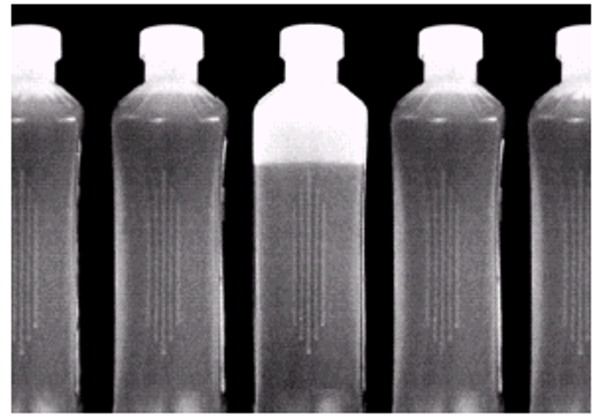
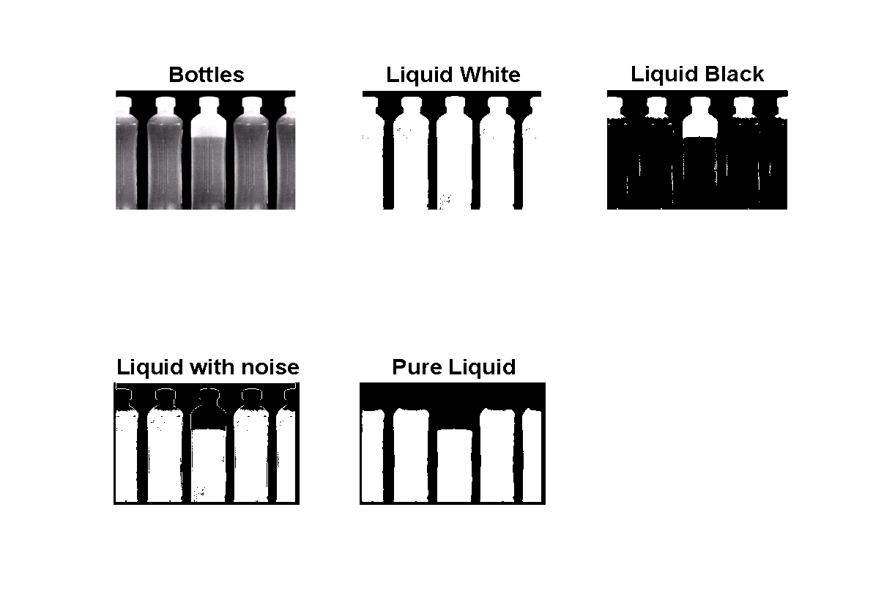
Segmentation of Water in Bottles
b = imread('bottles.jpg');
bL = im2bw(b,0.2);
bH = im2bw(b,0.7);
L = (bL-bH);
L1 = medfilt2(L,[9 9],'symmetric');
subplot(2,3,1),imshow(b),title('Bottles'),
subplot(2,3,2), imshow(bL), title('Liquid White'),
subplot(2,3,3), imshow(bH), title('Liquid Black'),
subplot(2,3,4), imshow(L), title('Liquid with noise'),
subplot(2,3,5), imshow(L1), title('Pure Liquid')

